Slide 1


Programming For Everybody
- AI Assisted VBA for Beginners
Xinran 07/2026

Slide 2
Agenda
What can VBA do?
VBA VS Python, VBA vs Excel Formula
How to enable VBA developer tab?
How to prompt, code and debug with AI?
Tasks
  Create a procedure
  Create a for loop
  Create a Macro button
  Calculated fields
  If-else statement
  Create a filter
  Merge dataset
  Email Generator (optional)
  Etc…
More resources for VBA

Slide 3

Problem Identified
Programming skills are getting more valued in the trading industry, but it is painful to start.
Our company is growing and the data we are handling is getting heavier and laptop sometimes crashes running old excel models.
Generative AI like Chatgpt and Copilot is getting so powerful and writing code has never been so easy, how can we fully unleash its potential to increase productivity?

Slide 4

Programming For Everybody
This series aims to empower absolute beginners to confidently explore programming in VBA, Python using AI as their best assistant to tackle simple daily tasks — without getting bogged down by complex syntax or overwhelming crash courses.
1. VBA
2. Python

Slide 5
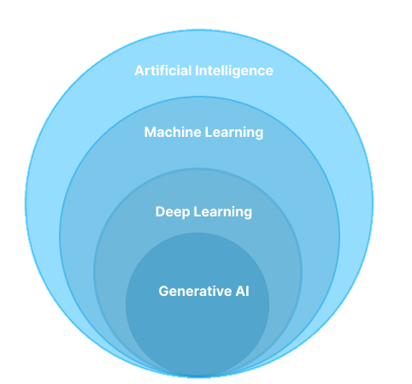
AI Demystified
AI-Assisted Python for Beginners Course
Giving machine human intelligence
Learning from data and find patterns
Predictive models (predict freight costs, margin, customer behaviours)
Learning with Deep Neural Networks
Help write AI models
Creating New Content using LLM
Chatgpt, Copilot, Claude, Deepseek
Notes:
AI: Making Machines Smart
AI (Artificial Intelligence) is a broad idea. It means making machines act like humans—think, make decisions, and do tasks on their own.
Machine Learning: Teaching Machines to Learn
Machine Learning is a part of AI. It teaches machines to learn from data and find patterns, without being told exactly what to do.
Deep Learning: Learning with Deep Neural Networks
Deep Learning is a special kind of Machine Learning. It uses neural networks—a system that works like the human brain—with many layers. Because of its depth, it’s great at complex tasks.
Generative AI: Creating New Content
Generative AI like chatgpt and copilot is a new type of AI that can create new content—like text, images, audio, or video. It’s powered by deep learning.

Slide 6
Excel formula VS VBA(macro)
Aspect | Excel Formulas | VBA
Purpose | Perform calculations directly in worksheet cells | Automate tasks, build custom logic, link other Office Apps
Ease of Use | Beginner-friendly, uses built-in functions | Requires programming knowledge
Speed to Implement | Fast for simple tasks | Slower to write initially, faster in long term for complex tasks
Flexibility | Constrained to predefined functions | Highly flexible
User Interaction | Minimal (formulas recalculate automatically) | Can create forms, message boxes, buttons
Maintainability | Easy to read and trace in cells | Harder to debug
One is not better than the other

Slide 7


VBA VS Python
AI-Assisted Python for Beginners Course
 | ‌VBA‌ | ‌Python‌
‌Environment‌ | Embedded in Excel | Separate installation
‌Primary Use‌ | Office automation | General-purpose (web dev, AI, including Office automation)
‌Learning Curve‌ | More acceptable for excel experts | Steeper initially to adapt but the language is simpler
‌Scalability‌ | Hard | Easy
‌Community | Less active | More active
Ideal for | Simple repetitive Excel tasks | Versatile tasks

Slide 8
VBA VS Python
 | ‌VBA‌ | ‌Python‌
‌Environment‌ | Embedded in Microsoft Office (Excel, Word) | Requires separate installation; runs independently
‌Primary Use‌ | Office automation (e.g., Excel macros) | General-purpose (data science, web dev, AI, including Office automation)
‌Learning Curve‌ | More acceptable for excel experts (similar excel formula way of calculation) | Steeper initially to adapt to the environment but the language is simpler and closer to English
‌Scalability‌ | Limited to Office apps; struggles with large datasets | Handles big data efficiently with packages
‌Community | Less active and older resources | More active and continuously evolving. Many tools available.
Ideal for | Simple repetitive Excel tasks (e.g., formatting, copy-pasting, filtering) | Versatile tasks that requires more flexibility, functionality or add-on intelligence.
Notes:
Less texts

Slide 9
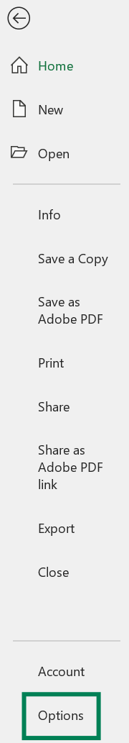
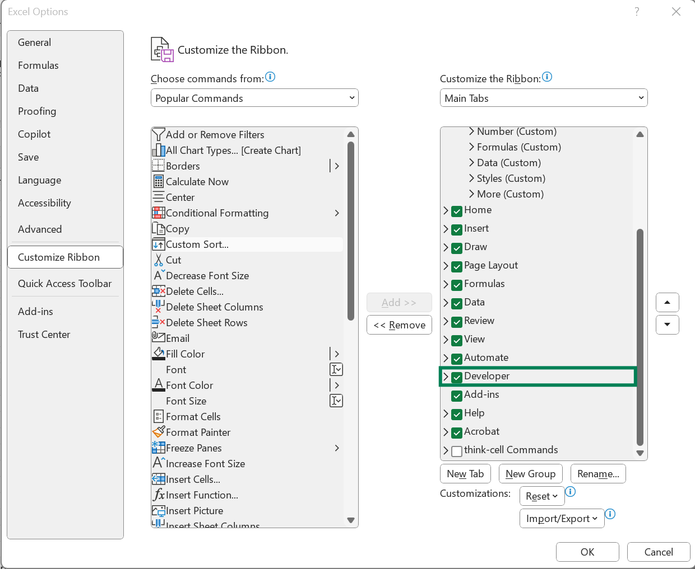
Enable VBA in excel and create xlsm file

Slide 10
Ready for Hands on Challenge?
Print welcome message
Comment
For Loop Iteration
Calculated fields
If-else statement
Create a filter
Merge datasets
Generate Outlook Email (optional)

Slide 11
VBA Studio Intro
Menu
Procedures in a module
How to run

Slide 12
How Coding has evolved
New Way
Traditional Way
Problem statement
Prompt with AI
Trial and error
Solution
Problem statement
Search online source like StackOverflow
Code out
Solution

Slide 13
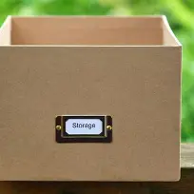
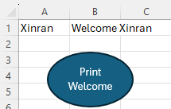
1. Print a welcome message
ws.Range("A1").Value
Prompt: Write a VBA code that read my name in A1 of Sheet1 and write Welcome + my name in B1.
Sub GreetUser()
Dim userName As String
Dim ws As Worksheet
Set ws = ThisWorkbook.Sheets("Sheet1")
userName = ws.Range("A1").Value
ws.Range("B1").Value = "Welcome " & userName
End Sub
Create variables
userName
Define which sheet
Reference cells
Set Value
Assign macro to a button
Notes:
Set for what purpose

Slide 14
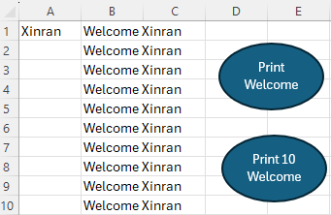
2. Print 10 welcome messages
Prompt: Write a VBA code that read my name in A1 of Sheet1 and write Welcome + my name in B1 to B10.
Sub GreetUserMultiple()
Dim userName As String
Dim ws As Worksheet
Dim i As Integer
Set ws = ThisWorkbook.Sheets("Sheet1")
userName = ws.Range("A1").Value
For i = 1 To 10
ws.Range("B" & i).Value = "Welcome " & userName
Next i
End Sub
Create variables
Define which sheet
For Loop Iteration
ws.Range("B" & i).Value means column B row i
The loop goes through B1 B2 B3 … to B10

Slide 15
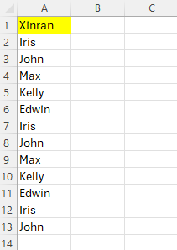
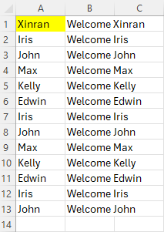
3. Print personal welcome messages
Prompt: Write a VBA code that read a list of names in column A of Sheet2 and write Welcome + person name in column B.
Sub GreetUserCustom ()
Dim ws As Worksheet
Dim lastRow As Integer
Dim i As Integer
Set ws = ThisWorkbook.Sheets("Sheet2")
lastRow = ws.Cells(ws.Rows.Count, "A").End(xlUp).Row
For i = 1 To lastRow
If ws.Cells(i, 1).Value <> "" Then
ws.Cells(i, 2).Value = "Welcome " & ws.Cells(i, 1).Value
End If
Next i
End Sub
For Loop Iteration
GreetUserCustom ()
Cells(i, 1) means column 1 row i
The loop goes through A1 A2 A3 … to last row
Notes:
We do not need to know how to write it from scratch, understand what the code is talking about. Ask AI to put comment guide you. Ask it to explain for you.

Slide 16
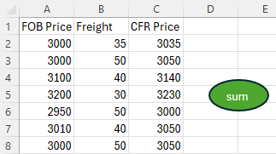
4. Sum up two columns
Try it yourself with your GenAI assistant
Prompt: In Sheet 3, add FOB Price in column A with Freight in column B to put into CFR Price in column C, do not change the column name. Write VBA code.
Sub AddPriceFreightSheet3()
Dim ws As Worksheet
Dim i As Long
Set ws = ThisWorkbook.Sheets("Sheet3")
lastRow = ws.Cells(ws.Rows.Count, "A").End(xlUp).Row
' Start from row 2 to preserve headers
For i = 2 To lastRow
ws.Range("C" & i).Value = ws.Range("A" & i).Value + ws.Range("B" & i).Value
Next i
End Sub
‘ Comment
Calculation
C2 = A2+B2
C3 = A3+B3
C4 = A4+B4
… until lastRow
Notes:
Do something manually but then use a function to do it to show it’s more convenient, sub/function.

Slide 17
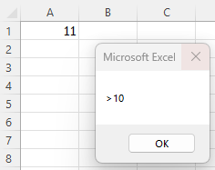
5. If-else Statement
Try it yourself with your GenAI assistant
Prompt:
Write a VBA code that checks the value in cell A1 in Sheet4.
If value > 10, display “>10";
if value = 10, display “=10";
otherwise, display “<10".
Sub CheckValueInSheet4()
Dim ws As Worksheet
Dim cellValue As Variant
Set ws = ThisWorkbook.Sheets("Sheet4")
cellValue = ws.Range("A1").Value
If cellValue > 10 Then
MsgBox ">10"
ElseIf cellValue = 10 Then
MsgBox "=10"
Else
MsgBox "<10"
End If
End Sub
If-Else Decision Making

Slide 18
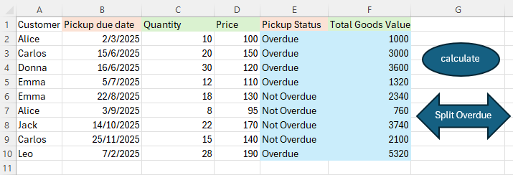
6. Pickup Overdue
Goal: Use vba to calculate Overdue status and Goods Value for open sales
Prompt: In sheet "Open Sales”, provide vba code to calculate Pickup Overdue Status in column 5 which is comparing today's date and the Pickup due date in column B, if today’s date is bigger then status is Overdue, otherwise Not Overdue.
Calculate Total Goods Value in column 6 which is Quantity (column 3)*Price (column 4)?
The first row is for headers
Try it yourself with your GenAI assistant
Sub CalculateDetails()
Dim ws As Worksheet
Dim lastRow As Long, i As Long
Dim todayDate As Date, dueDate As Date
Set ws = ThisWorkbook.Worksheets("Open Sales")
lastRow = ws.Cells(ws.Rows.Count, 1).End(xlUp).Row
todayDate = Date
For i = 2 To lastRow
dueDate = CDate(ws.Cells(i, 2).Value)
' Calculate values
ws.Cells(i, 5).Value = IIf(dueDate < todayDate, "Overdue", "Not Overdue")
ws.Cells(i, 6).Value = ws.Cells(i, 3).Value * ws.Cells(i, 4).Value
Next i
MsgBox "Details Calculated", vbInformation
End Sub
Cells(i, 2) means column 2 row i

Slide 19
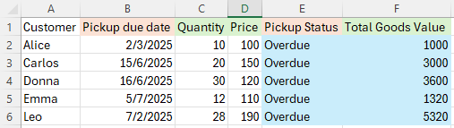
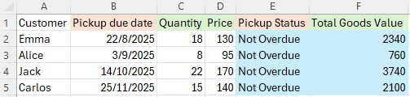
7. Split with conditions
Try it yourself with your GenAI assistant
Prompt:
Write a VBA macro that splits data from the "Open Sales" sheet into two new sheets: "Overdue" and "NotOverdue", based on the value in column E.
The macro should:
Delete the "Overdue" and "NotOverdue" sheets if they already exist.
Copy headers to both new sheets.
Copy each row to the appropriate sheet depending on whether column E says "Overdue" or not.
Overdue Sheet
NotOverdue Sheet

Slide 20
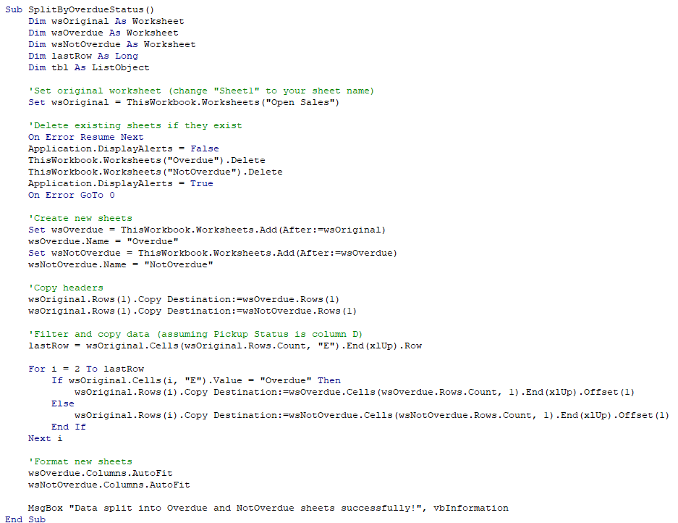
Filter
If original is Overdue, move to Overdue sheet
Else, move to NotOverdue sheet

Slide 21
Sub SplitByOverdueStatus()
Dim wsOriginal As Worksheet
Dim wsOverdue As Worksheet
Dim wsNotOverdue As Worksheet
Dim lastRow As Long
Dim tbl As ListObject
'Set original worksheet (change "Sheet1" to your sheet name)
Set wsOriginal = ThisWorkbook.Worksheets("Open Sales")
'Delete existing sheets if they exist
On Error Resume Next
Application.DisplayAlerts = False
ThisWorkbook.Worksheets("Overdue").Delete
ThisWorkbook.Worksheets("NotOverdue").Delete
Application.DisplayAlerts = True
On Error GoTo 0
'Create new sheets
Set wsOverdue = ThisWorkbook.Worksheets.Add(After:=wsOriginal)
wsOverdue.Name = "Overdue"
Set wsNotOverdue = ThisWorkbook.Worksheets.Add(After:=wsOverdue)
wsNotOverdue.Name = "NotOverdue"
'Copy headers
wsOriginal.Rows(1).Copy Destination:=wsOverdue.Rows(1)
wsOriginal.Rows(1).Copy Destination:=wsNotOverdue.Rows(1)
'Filter and copy data (assuming Pickup Status is column D)
lastRow = wsOriginal.Cells(wsOriginal.Rows.Count, "E").End(xlUp).Row
For i = 2 To lastRow
If wsOriginal.Cells(i, "E").Value = "Overdue" Then
wsOriginal.Rows(i).Copy Destination:=wsOverdue.Cells(wsOverdue.Rows.Count, 1).End(xlUp).Offset(1)
Else
wsOriginal.Rows(i).Copy Destination:=wsNotOverdue.Cells(wsNotOverdue.Rows.Count, 1).End(xlUp).Offset(1)
End If
Next i
'Format new sheets
wsOverdue.Columns.AutoFit
wsNotOverdue.Columns.AutoFit
MsgBox "Data split into Overdue and NotOverdue sheets successfully!", vbInformation
End Sub

Slide 22
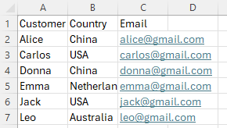
8. Merge dataset
Try it yourself with your GenAI assistant
Prompt:
Write a VBA macro that fills column G in the "Overdue" sheet with email addresses from the "Map" sheet.
In "Overdue", customer names are in column A.
In "Map", customer names are in column A and email addresses are in column C.
Add the header "Email" to column G if missing.
Use VLOOKUP (no nested loops)
Show a completion message when done.

Slide 23
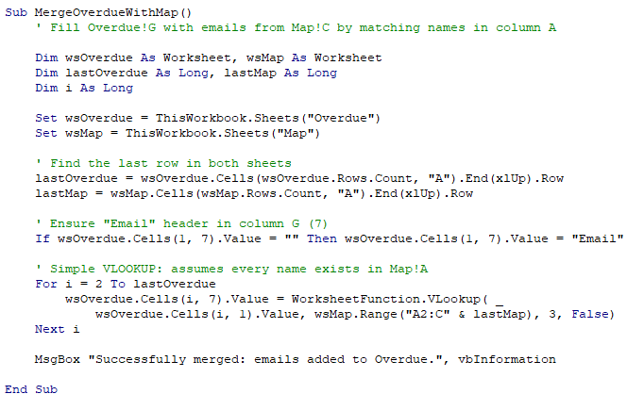

Slide 24
9. Email Generator (optional)
Write a VBA macro for Excel that drafts overdue pickup notification emails using data from the "Overdue" sheet.
Columns:
  A: Customer Name
  B: Pickup Due Date
  C: Quantity
  D: Unit Price
  G: Total Goods Value
  H: Email Address
For each row (starting from row 2), create an Outlook email to the customer, using HTML formatting.
The subject should include “URGENT: Overdue Pickup Notification - [Customer Name]”.
The body should show: Due Date, Days Overdue, Quantity, Unit Price, Total Value, and an urgent action message.
Show a message box when all emails have been generated.

Slide 25
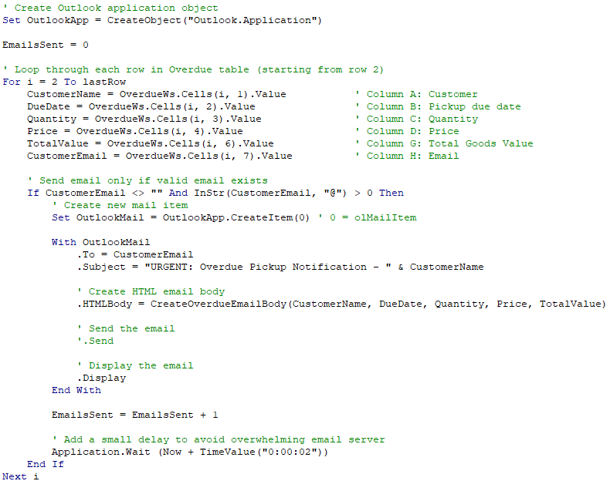

Slide 26
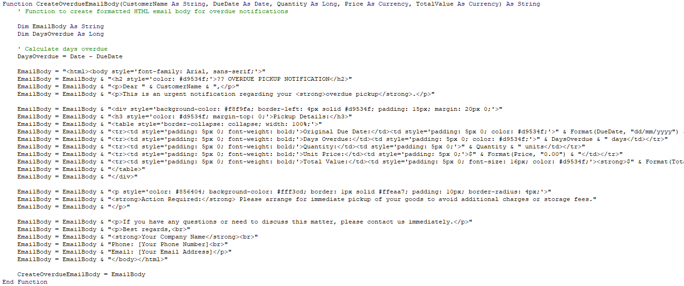

Slide 27
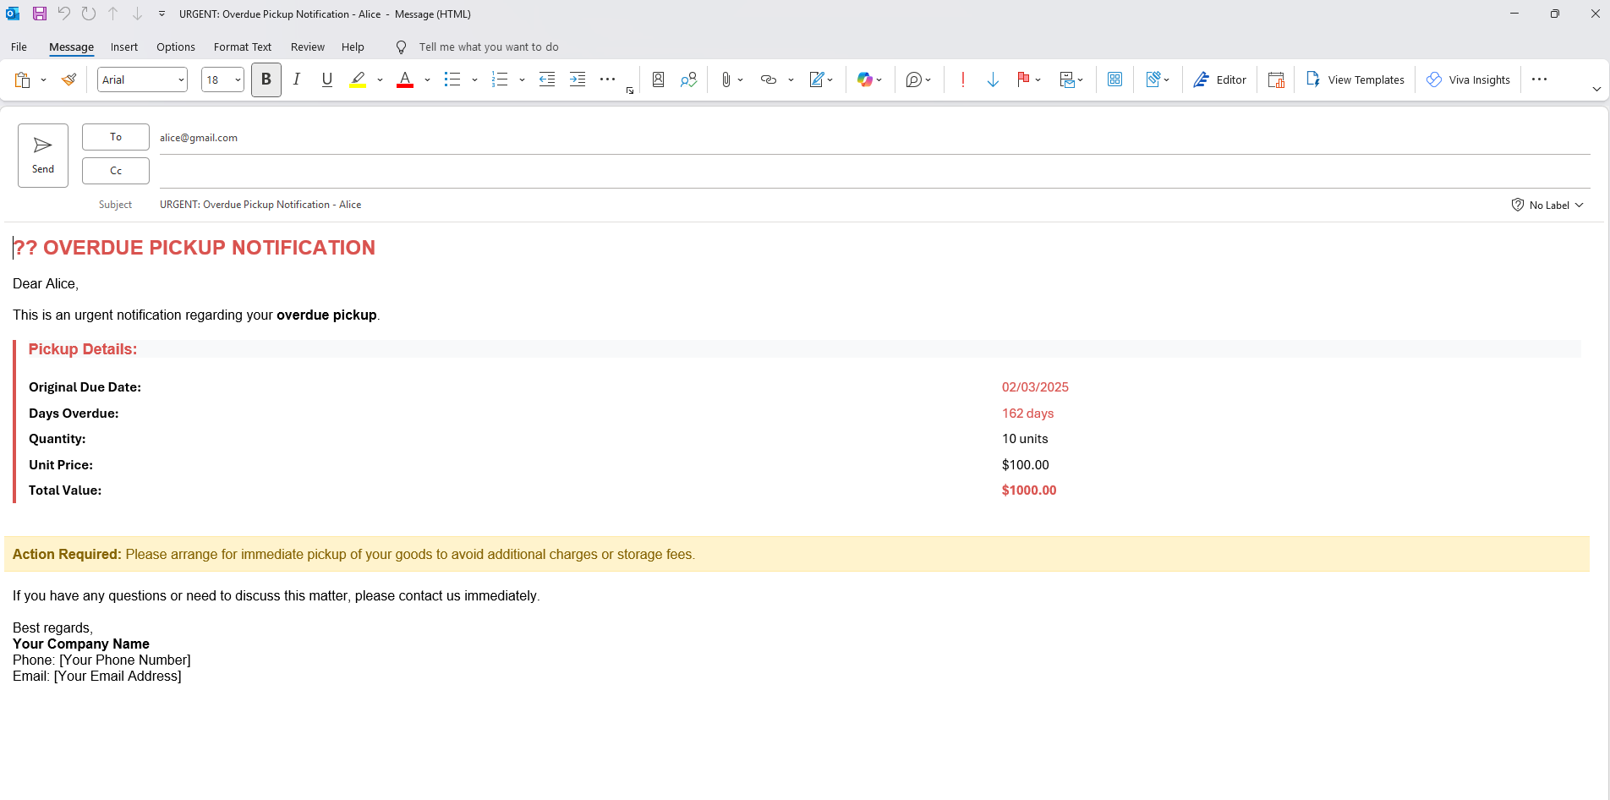

Slide 28
End Note
It is good and normal to make mistakes, and it is 100% ok not to understand the code completely.
Give an accurate prompt and let AI do 80% of the work, then try to read through the code & comment and debug with AI again.
AI is your best friend, do not be afraid to ask it stupid questions and tell it that the answer is bad or needs modification. Its job is to help you as much as possible and your job is to tell it what you want as detailed as possible.
My last challenge to you would be to come up with something in your work that you think can be optimized, or something analytical that can be created using VBA.
Notes:
It takes effort and stepping out of your comfort zone, but I think it would be very beneficial for your understanding of AI-Assisted Programming and personal development. Help each other and brainstorm, debug together.

Slide 29
Thank you for your attention!
More resources online
Get your AI-Assisted VBA verification by sending me a screenshot of your developer tab with vba code
Have fun exploring VBA with the help of AI!

